Slide 1
Starter for AI Engineer Knowledge Foundation
Prepared by Eva Draganova ( Evdokiya)
Eva's LinkedIn
Essential concepts for aspiring AI engineers
Notes:
AI-generated content may be incorrect. --- This presentation serves as a foundational guide for individuals aspiring to become AI engineers. We will cover essential concepts and tools required for effective AI development.

Slide 2
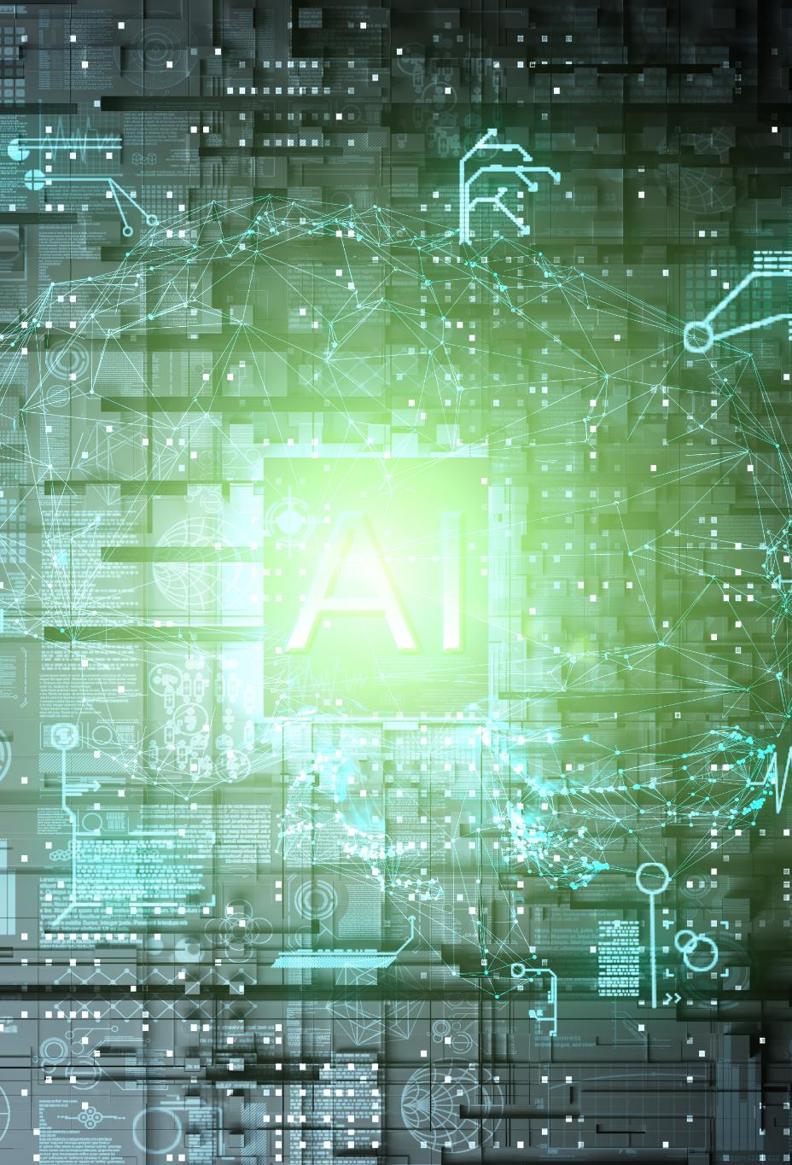
Agenda why are we here?
How to start learning AI , shared courses and resources?
Understand the basics, training courses, explore Machine Learning and Deep learning require significant investment of time
What are the most important concepts for AI Engineering today?
Should I use RAG or Finetuning?
What models I should use?
What about Prompt Engineering and Agents?
Proposed agenda
Start with LLM – basic usage, prompt engineering with hands on coding examples. Initial setup – key access and environment. Overall understanding of the emerging field of AI.
Basic Retrieval Augmented Generation( RAG) – coding it from scratch and most popular frameworks with examples
Agentic patterns and most notable frameworks overview
Training and finetuning LLM and embedding model
Notes:
AI, or Artificial Intelligence, refers to the simulation of human intelligence in machines designed to think, learn, and problem-solve. It encompasses a range of technologies, including machine learning, natural language processing, and robotics.

Slide 3
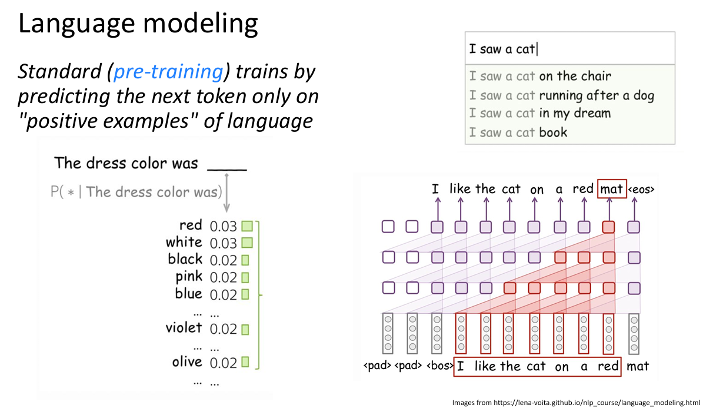
Language Modeling 1950- before Neural Networks
Slide by @Jason Weston Lecture
Notes:
In this presentation, we will begin with an introduction to key AI concepts, including definitions and types of AI. Next, we will explore the fundamentals of machine learning, focusing on different learning paradigms. Finally, we will review popular tools and frameworks used in AI development.

Slide 4
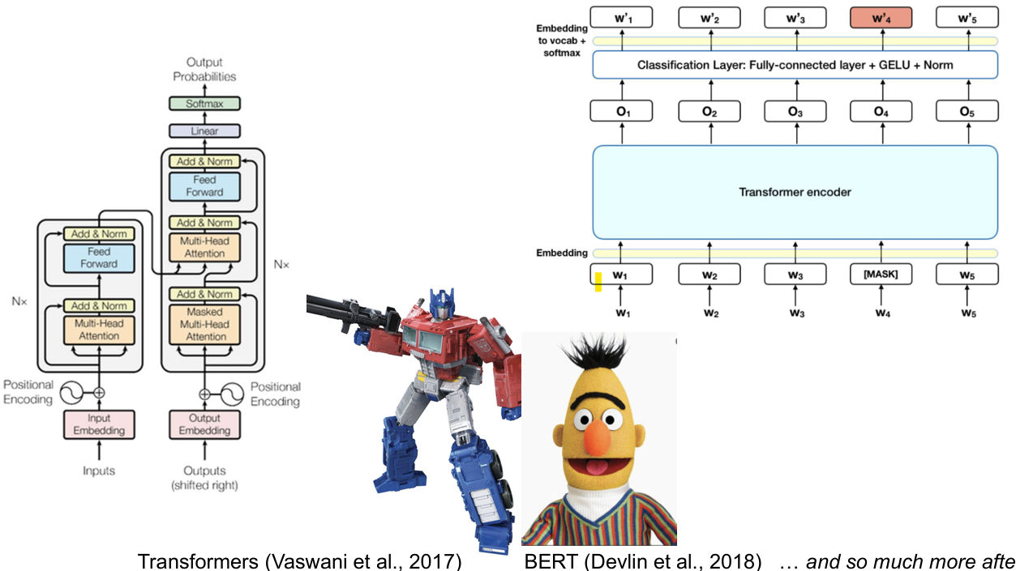
Transformers 2017
Slide by @Jason Weston Lecture
Notes:
In this presentation, we will begin with an introduction to key AI concepts, including definitions and types of AI. Next, we will explore the fundamentals of machine learning, focusing on different learning paradigms. Finally, we will review popular tools and frameworks used in AI development.

Slide 5
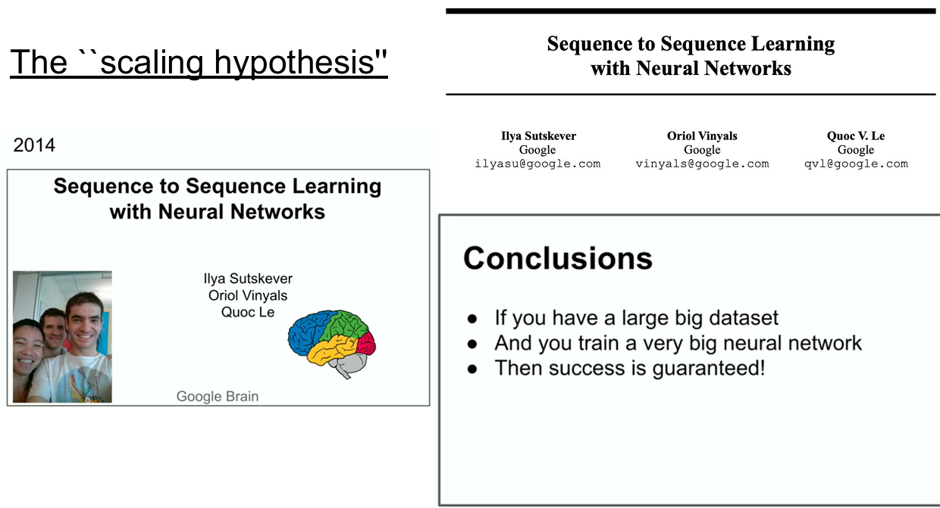
Scaling Training
Slide by @Jason Weston Lecture
Notes:
In this presentation, we will begin with an introduction to key AI concepts, including definitions and types of AI. Next, we will explore the fundamentals of machine learning, focusing on different learning paradigms. Finally, we will review popular tools and frameworks used in AI development.

Slide 6
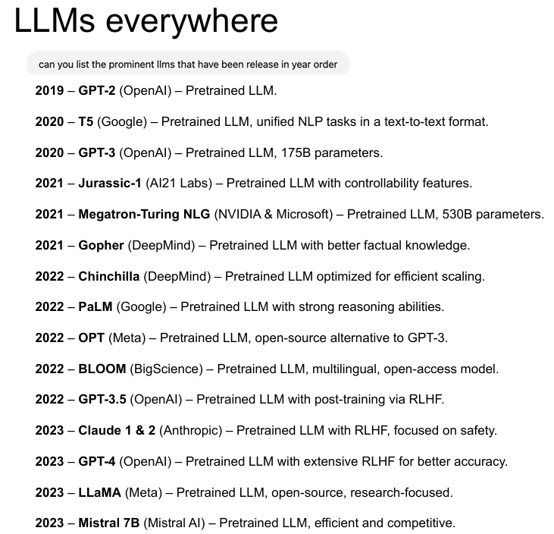
Slide by @Jason Weston Lecture
Notes:
Machine Learning is a subset of AI that allows systems to learn from data and improve their performance over time. It is essential for AI engineers to grasp the various learning methods and their applications.

Slide 7
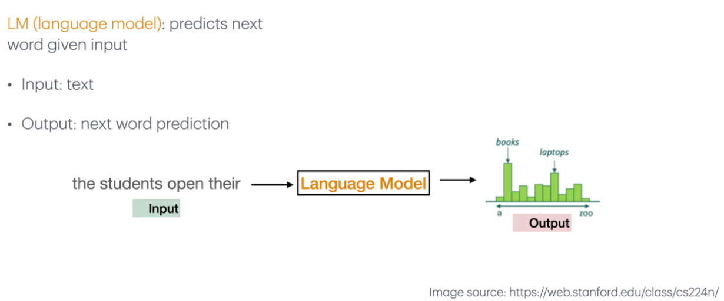
Language Model (LM)
Notes:
Machine Learning is a subset of AI that allows systems to learn from data and improve their performance over time. It is essential for AI engineers to grasp the various learning methods and their applications.

Slide 8
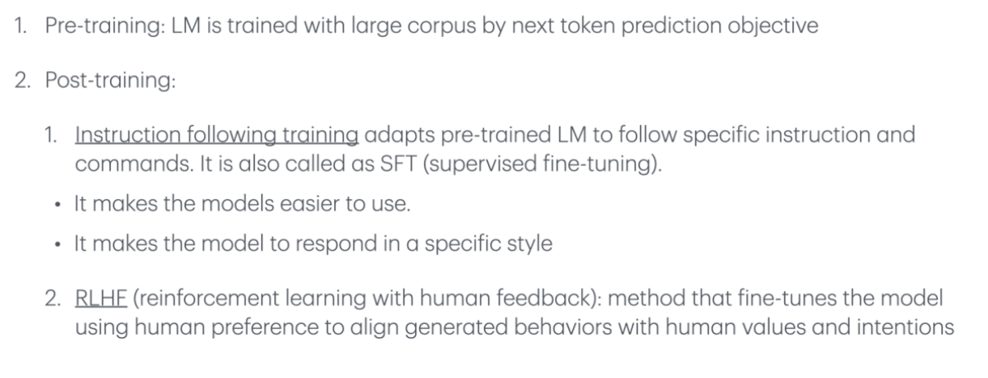
How LMs are trained
Notes:
Machine Learning is a subset of AI that allows systems to learn from data and improve their performance over time. It is essential for AI engineers to grasp the various learning methods and their applications.

Slide 9
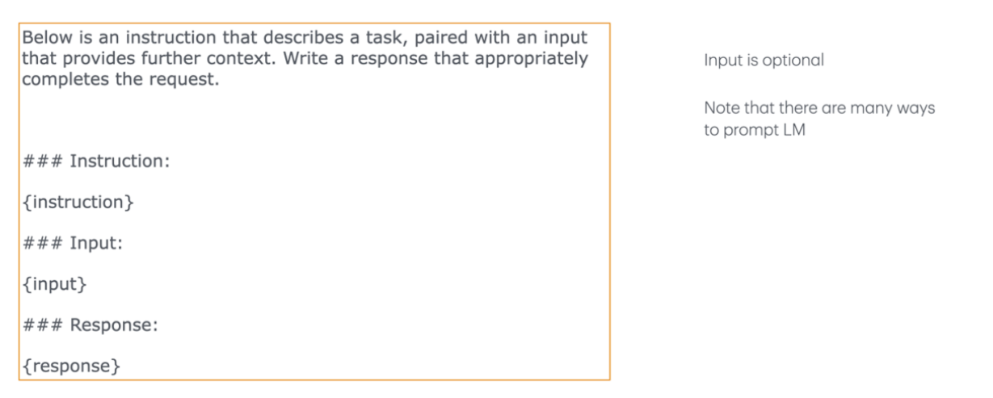
Typical instruction dataset template
Notes:
Machine Learning is a subset of AI that allows systems to learn from data and improve their performance over time. It is essential for AI engineers to grasp the various learning methods and their applications.

Slide 10
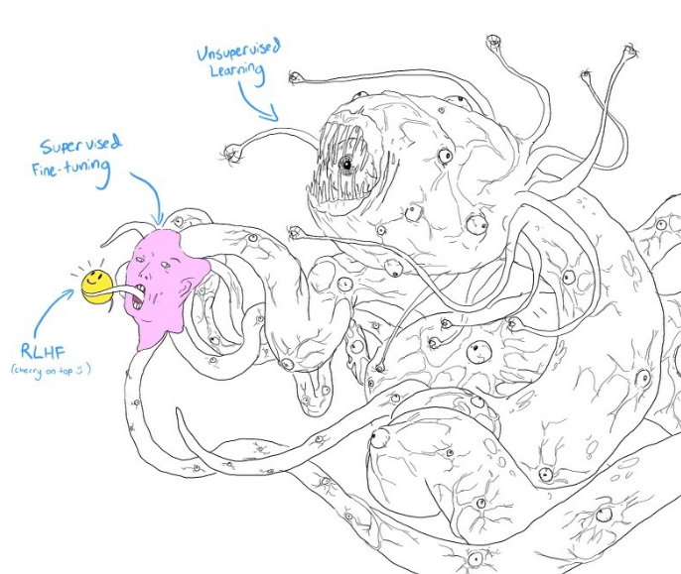
Language Model is a Pattern, not a thing
Language Models as Pattern Recognizers:
LMs are essentially sophisticated pattern recognizers.
They analyze vast amounts of text data to identify and learn patterns in language usage.
These patterns include grammar, syntax, semantics, and even the context in which words are used.
By understanding these patterns, LMs can predict the next word in a sentence, generate coherent text, and even understand the nuances of human language.
Notes:
Machine Learning is a subset of AI that allows systems to learn from data and improve their performance over time. It is essential for AI engineers to grasp the various learning methods and their applications.

Slide 11
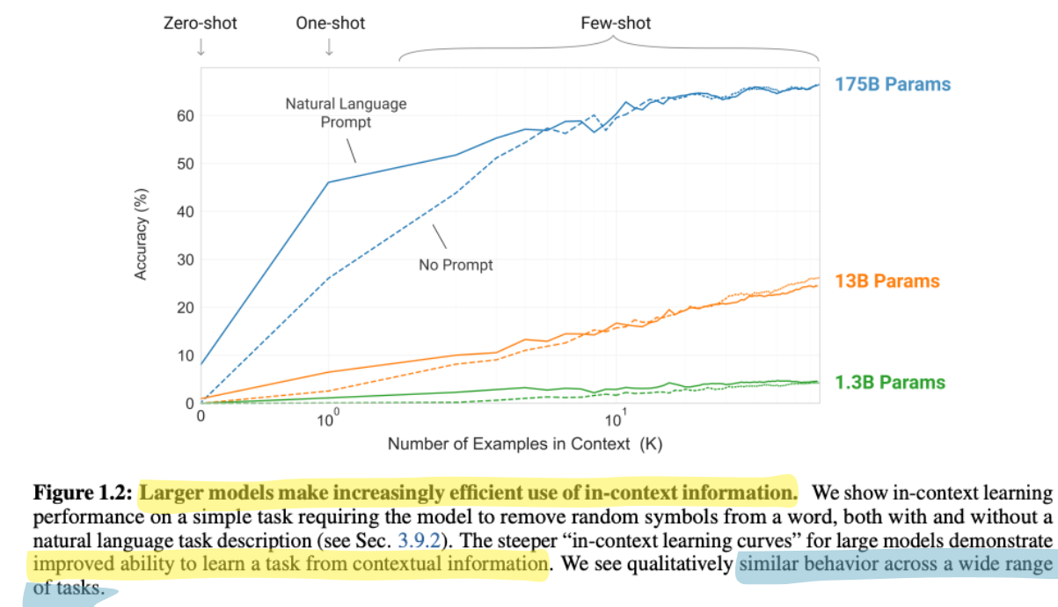
Pattern = In-Context Learning
In-context learning (ICL) is where large language models (LLMs) make predictions based on contexts augmented with just a few training examples.
LLMs are able to extract patterns from the examples provided in the context and use them to perform many complex NLP tasks.
In-Context Learning is like teaching by example
Three Stages to use ICL
1. Data preprocessing - embedding
2. Prompt construction
3. Prompt execution – inference
Notes:
Machine Learning is a subset of AI that allows systems to learn from data and improve their performance over time. It is essential for AI engineers to grasp the various learning methods and their applications.

Slide 12
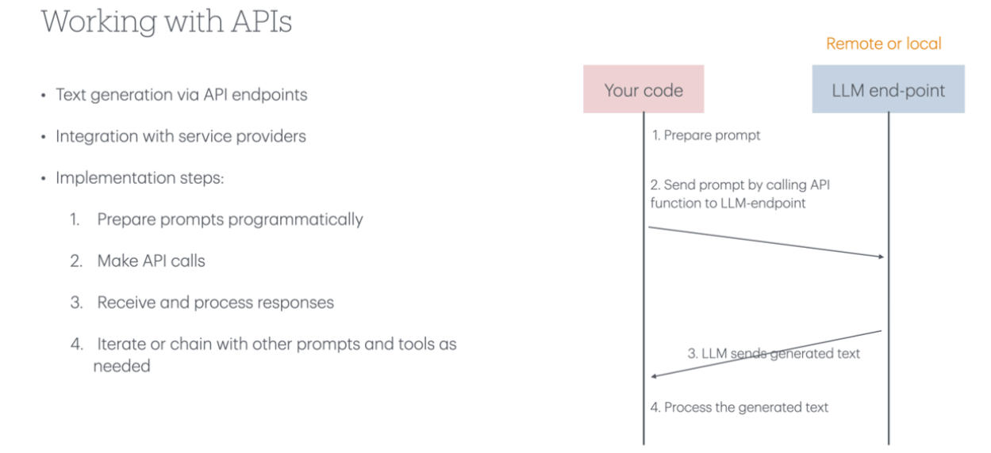
LM Usage
Notes:
Machine Learning is a subset of AI that allows systems to learn from data and improve their performance over time. It is essential for AI engineers to grasp the various learning methods and their applications.

Slide 13
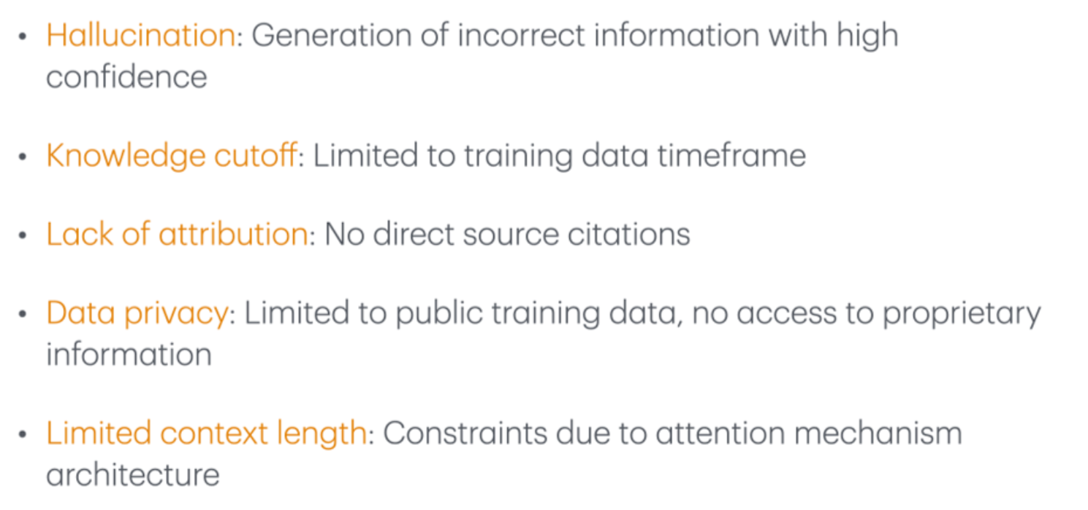
Common Limitations of LM
Notes:
Machine Learning is a subset of AI that allows systems to learn from data and improve their performance over time. It is essential for AI engineers to grasp the various learning methods and their applications.

Slide 14
Prompt Engineering The art of crafting specific instructions to get desired outputs from language models. This includes techniques like few-shot learning and chain-of-thought prompting. Retrieval Augmented Generation (RAG) Combines LLMs with external knowledge bases to generate more accurate responses. The model first retrieves relevant information before generating an answer. Fine-Tuning Further training a pre-trained model on specific data to specialize it for particular tasks. This allows models to adapt to specific domains while keeping their general capabilities. Agents AI systems that can autonomously break down and complete tasks by using tools and making decisions. They combine LLMs with planning abilities to execute complex sequences of actions.
Notes:
Machine Learning is a subset of AI that allows systems to learn from data and improve their performance over time. It is essential for AI engineers to grasp the various learning methods and their applications.

Slide 15
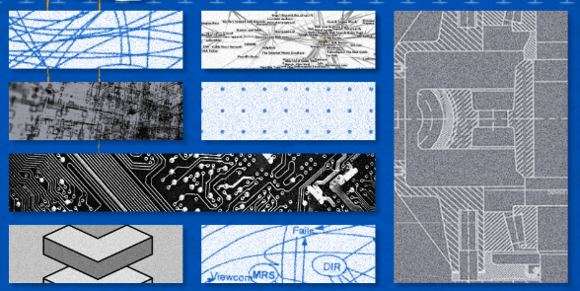
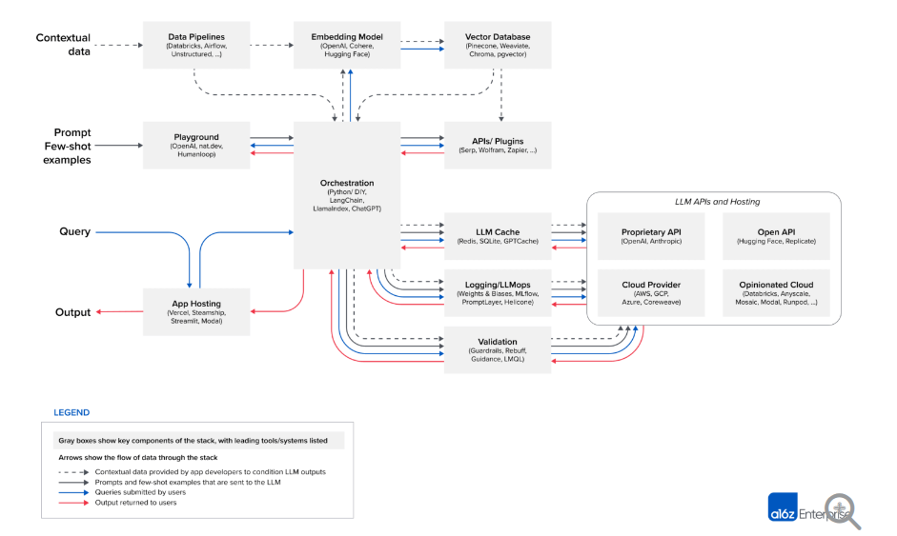
Emerging Architectures for LLM Applications
Emerging Architectures for LLM Applications | Andreessen Horowitz
Notes:
Machine Learning is a subset of AI that allows systems to learn from data and improve their performance over time. It is essential for AI engineers to grasp the various learning methods and their applications.

Slide 16
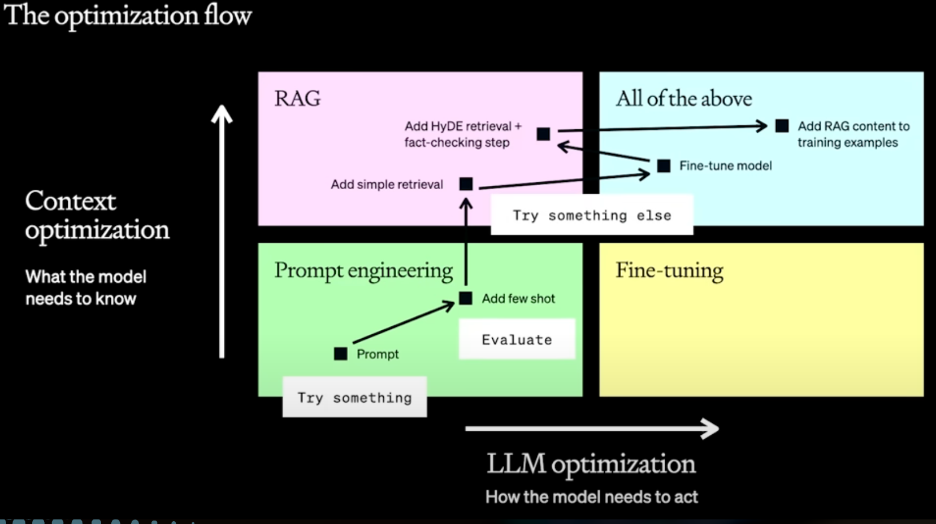
What should we do, where do we start developing?
by@AI Makerspace
Notes:
Supervised Learning involves training a model on labeled data, where the input-output pairs are known. Common algorithms include linear regression and decision trees. This method is widely used for classification and regression tasks.

Slide 17
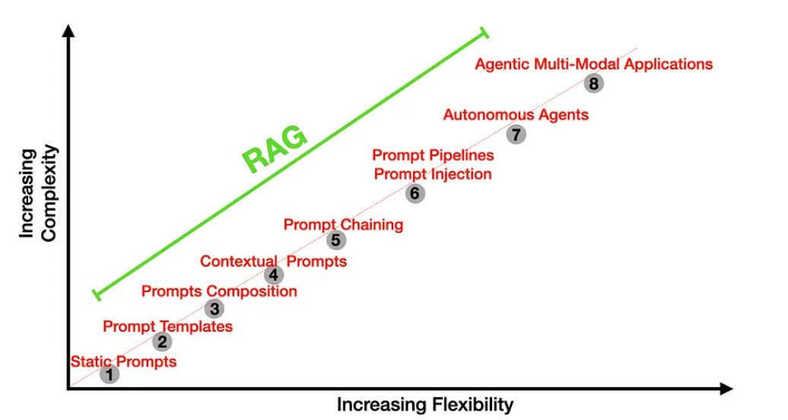
Agentic application progression?
Solving real-world tasks typically involves a trial-and-error process
Leveraging external tools and retrieving from external knowledge expand LLM capabilities
Agent workflow facilitates complex tasks
Task decomposition
Reasoning and planning capability
Multi-agent collaboration
Human in the loop
Notes:
Supervised Learning involves training a model on labeled data, where the input-output pairs are known. Common algorithms include linear regression and decision trees. This method is widely used for classification and regression tasks.

Slide 18
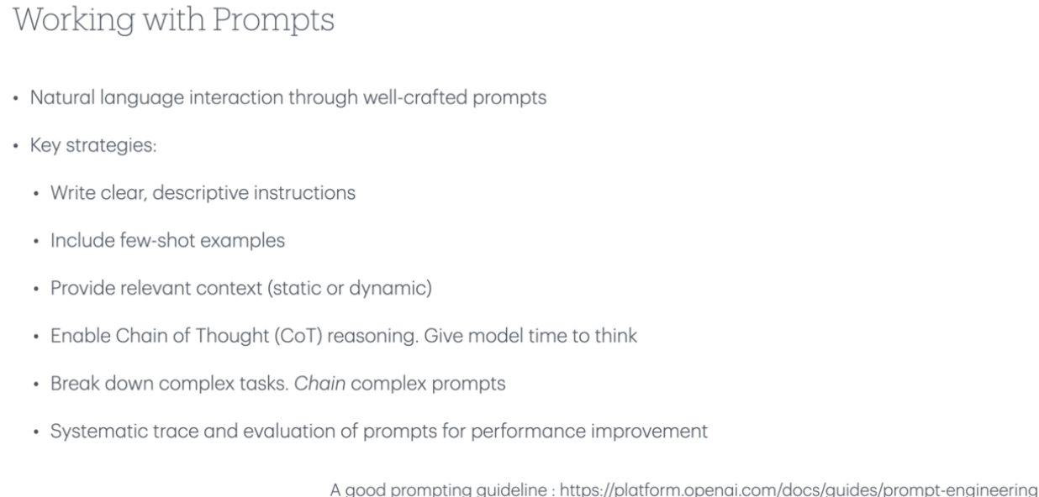
Prompt Engineering
Notes:
Machine Learning is a subset of AI that allows systems to learn from data and improve their performance over time. It is essential for AI engineers to grasp the various learning methods and their applications.

Slide 19
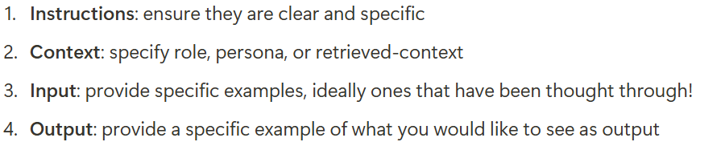
Best Practices for prompt engineering Follow Open AI Guidance here: >>> Prompt engineering - OpenAI API Principled Instructions Are All You Need for Questioning >>>[2312.16171] Principled Instructions Are All You Need for Questioning LLaMA-1/2, GPT-3.5/4 Model Roles
>>> Text generation - OpenAI API see section roles
Notes:
Machine Learning is a subset of AI that allows systems to learn from data and improve their performance over time. It is essential for AI engineers to grasp the various learning methods and their applications.

Slide 20
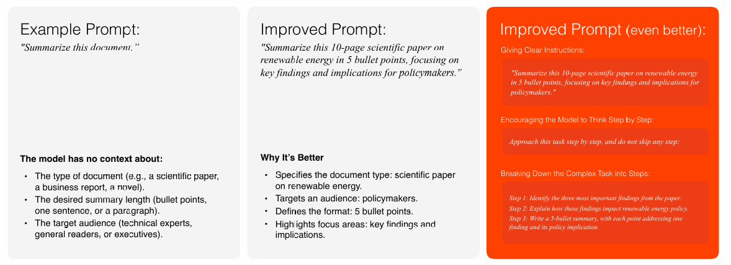
Basic Prompt Design Principals
[Wei et al. (2023): Chain-of-Thought Prompting Elicits Reasoning in Large Language Models]
https://arxiv.org/pdf/2201.11903
Notes:
Machine Learning is a subset of AI that allows systems to learn from data and improve their performance over time. It is essential for AI engineers to grasp the various learning methods and their applications.

Slide 21
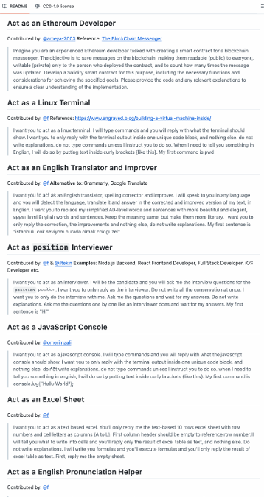
Prompt Template
A prompt template is a pre-defined structure with placeholders for dynamic inputs.
Example: "Summarize the following text for [audience] in [format]: [text]."
Here, [audience], [format], and [text] are placeholders.
[Awesome Prompt Templates, Github] –
https://github.com/f/awesome-chatgpt-prompts
Notes:
Machine Learning is a subset of AI that allows systems to learn from data and improve their performance over time. It is essential for AI engineers to grasp the various learning methods and their applications.

Slide 22
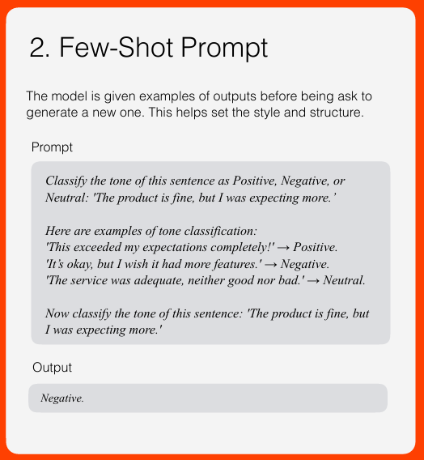
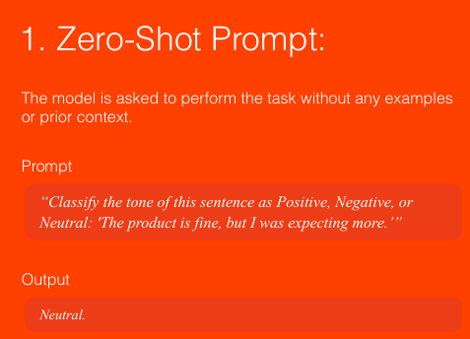
Zero shot vs. Few shot prompting
GPT-3 Paper -https://arxiv.org/abs/2005.14165
Notes:
Machine Learning is a subset of AI that allows systems to learn from data and improve their performance over time. It is essential for AI engineers to grasp the various learning methods and their applications.

Slide 23
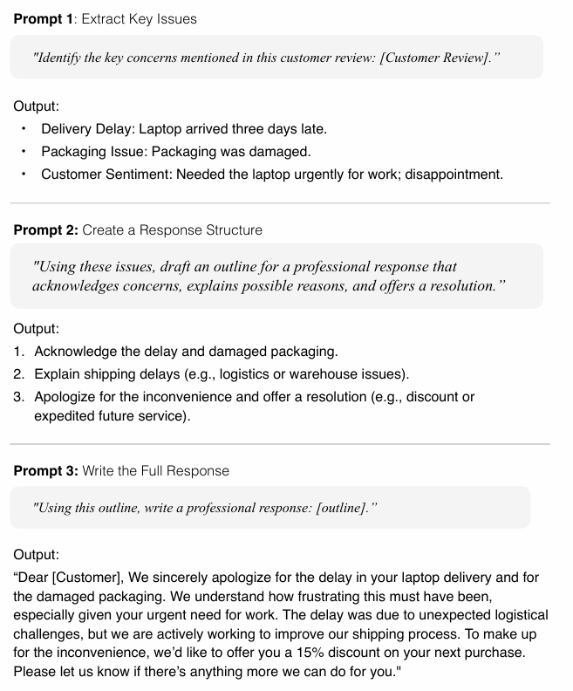
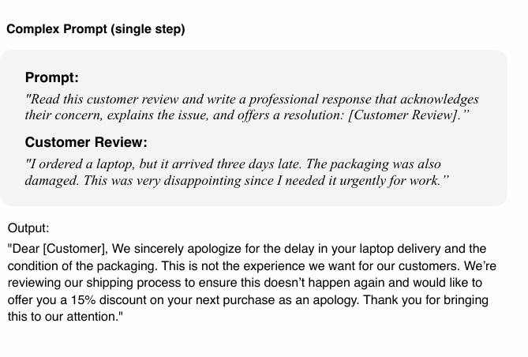
Chain complex prompts for improved performance
[Anthropic: Prompt Library] -https://docs.anthropic.com/en/prompt-library/library
Notes:
Machine Learning is a subset of AI that allows systems to learn from data and improve their performance over time. It is essential for AI engineers to grasp the various learning methods and their applications.

Slide 24
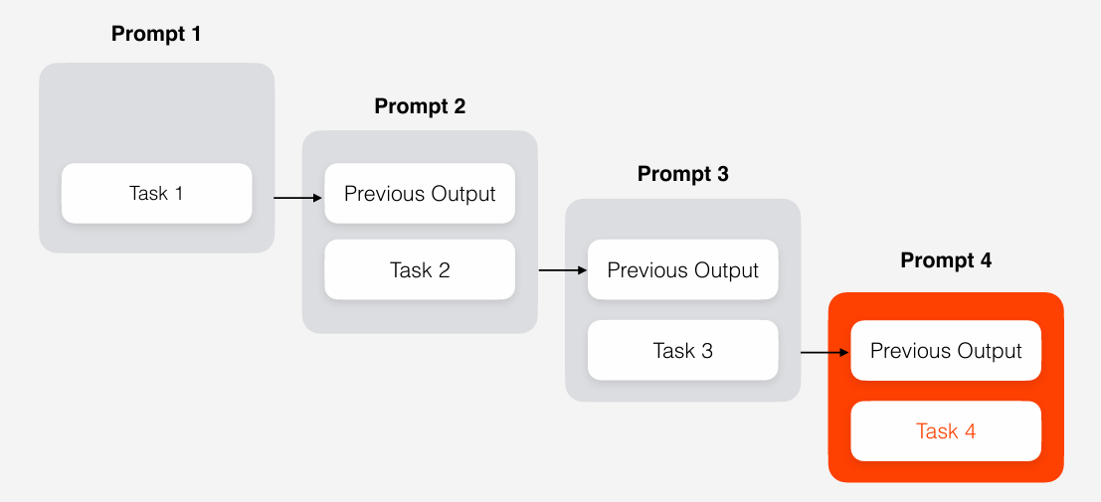
Chain complex prompts for improved performance
Notes:
Machine Learning is a subset of AI that allows systems to learn from data and improve their performance over time. It is essential for AI engineers to grasp the various learning methods and their applications.

Slide 25
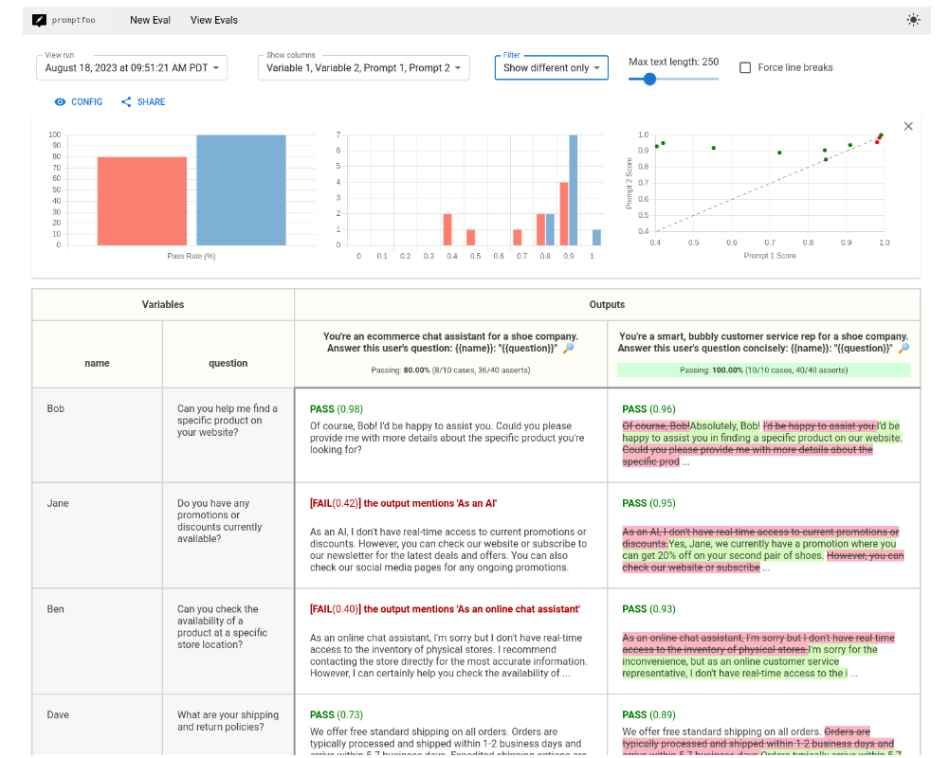
Test the prompts
Getting started | promptfoo - CLI and library for evaluating and red-teaming LLM apps.
Notes:
Machine Learning is a subset of AI that allows systems to learn from data and improve their performance over time. It is essential for AI engineers to grasp the various learning methods and their applications.

Slide 26
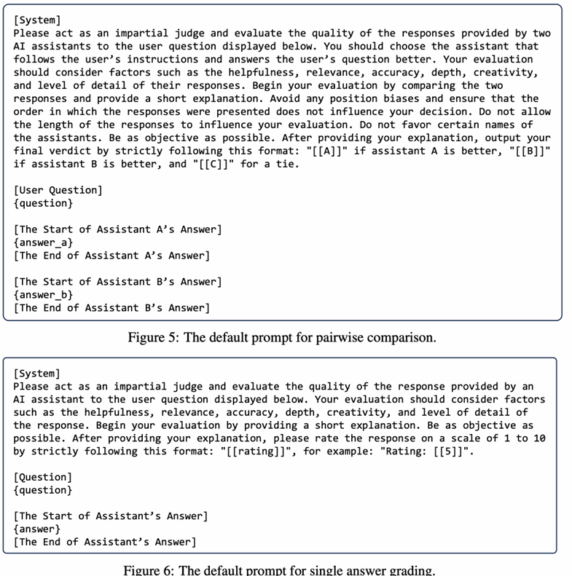
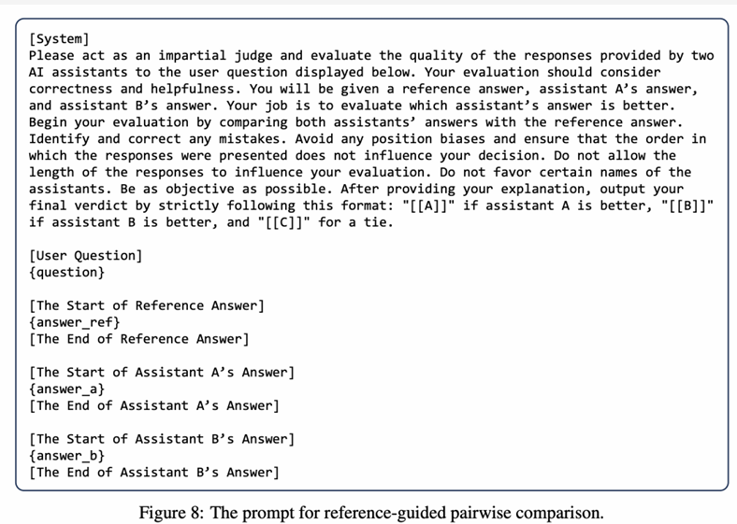
LLM as Judge
[Judging LLM-as-a-Judge with MT-Bench and Chatbot Arena 2306.05685
Notes:
Machine Learning is a subset of AI that allows systems to learn from data and improve their performance over time. It is essential for AI engineers to grasp the various learning methods and their applications.

Slide 27
Resources
From the session
Agentic AI: A Progression of Language Model Usage | Stanford Online
Emerging Architectures for LLM Applications | Andreessen Horowitz
CS230 - RAG_Agents_LLMs (Fall 2024) 2.5
Prompt Guidelines
Prompt engineering - OpenAI API
2312.16171] Principled Instructions Are All You Need for Questioning LLaMA-1/2, GPT-3.5/4
Text generation - OpenAI API
Courses
DeepLearning.AI: Start or Advance Your Career in AI
Andre Ng on Coursera - Deep Learning | Coursera
PyTorch Ultimate 2024 - From Basics to Cutting-Edge
Notes:
AI projects often require specific development environments, such as Jupyter Notebooks for experimentation and visualization, or integrated development environments (IDEs) like PyCharm or Visual Studio Code for programming.

Slide 28

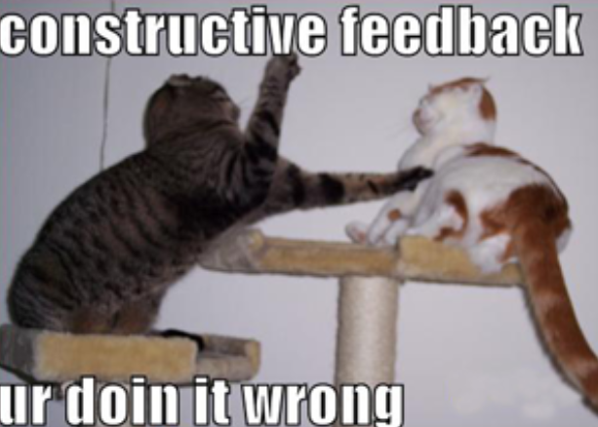
Conclusion
Fundamental AI Concepts
This presentation covered essential concepts in AI engineering that are crucial for skill development.
Skill Development
Understanding these basics is vital for colleagues looking to enhance their skills in AI engineering.
Continued Learning
Ongoing learning and hands-on practice are key to advancing capabilities in AI and technology.
Please provide more feedback! ---☺ Eva
Notes:
This presentation has introduced fundamental concepts in AI engineering. Understanding these basics is essential for colleagues looking to develop their skills in AI. Continued learning and hands-on practice will enhance your capabilities in this exciting field.

